Slide 1
AI-Powered Legal Documentation Assistant
PIP104 University Project-II
Review-2
Batch Number: CAI-G04
Roll Number | Student Name
20211CAIOO76 | E BHAVANI
20211CAI0064 | S SANJANA
20211CAI0065 | SIRI HG
20211CAI0174 | MOULYA HM
Under the Supervision of,
Dr. Swathi Sharma
Associate Professor
School of Computer Science & Engineering
Presidency University
Name of the Program: Bachelor of Technology
Name of the HoD: Dr. Zafar Ali Khan N
Name of the Program Project Coordinator: Dr. Afroz Pasha
Name of the School Project Coordinators: Dr. Sampath A K / Dr. Abdul Khadar A / Mr. Md Ziaur Rahman

Slide 2
Introduction
The AI-Powered Legal Documentation Assistant is an advanced tool designed to simplify and automate the process of drafting, reviewing, and managing legal documents.
It leverages cutting-edge Natural Language Processing (NLP) and Machine Learning (ML) algorithms to assist legal professionals in efficiently handling complex legal texts.
The tool automates contract drafting, clause analysis, and compliance verification, ensuring that documents align with legal standards and best practices. By minimizing manual effort, it reduces the risk of human errors and enhances the accuracy of legal documentation.
This AI-driven solution significantly improves workflow efficiency, allowing lawyers, law firms, and corporate legal departments to focus on critical legal tasks rather than repetitive documentation processes.
Ultimately, it enhances productivity, streamlines legal operations, and ensures that legal documents are prepared with speed, precision, and compliance.

Slide 3
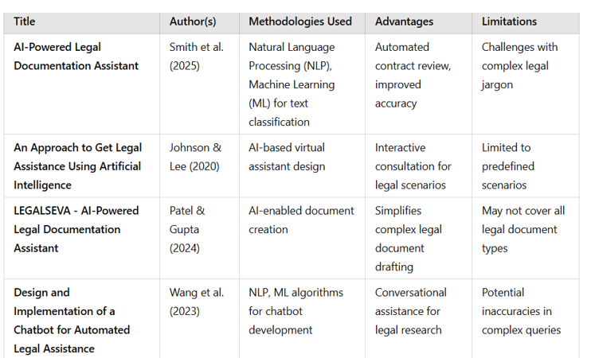
Literature Review

Slide 4
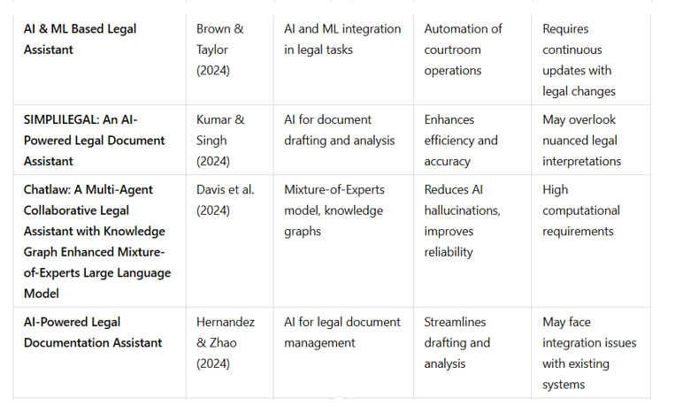
Literature Review

Slide 5
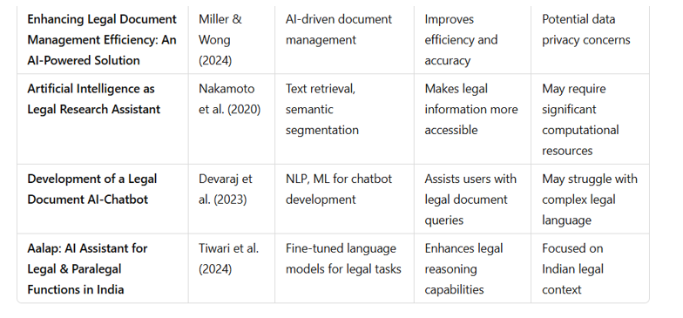
Literature Review

Slide 6
Proposed Method
The system utilizes Natural Language Processing (NLP) to analyze legal terminologies, clauses, and document structures, ensuring accurate understanding and processing of legal texts. This helps in identifying key legal entities such as parties, obligations, and deadlines.
It automates document generation by providing AI-driven templates for contracts, agreements, and other legal paperwork. Users can input key details, and the system will generate a structured legal document while maintaining accuracy and compliance.
An intelligent search and retrieval system allows users to quickly find relevant legal documents, case laws, and contract clauses. This is powered by semantic search and similarity-based retrieval methods, making legal research more efficient.
Machine learning models analyze past legal documents and cases to predict potential legal risks and suggest optimizations in contract terms. This proactive approach helps in minimizing legal vulnerabilities and enhancing document quality.
The system integrates with legal databases and APIs, ensuring that legal documents remain updated with the latest laws, regulations, and compliance requirements. This reduces the risk of outdated or incorrect legal information.
Secure document handling is implemented through encryption techniques and access control mechanisms to ensure confidentiality and data privacy. This safeguards sensitive legal information from unauthorized access and cyber threats.

Slide 7
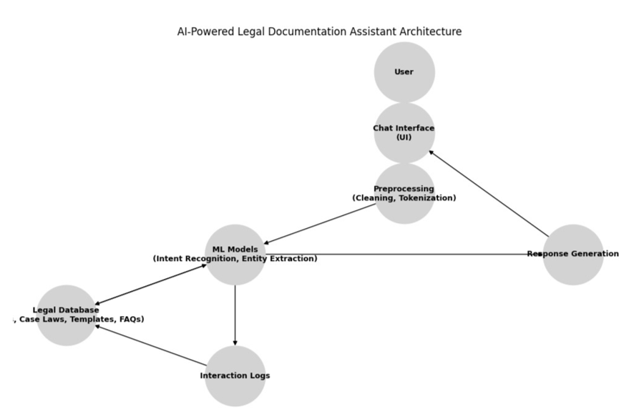
Architecture Diagram

Slide 8
Objectives
Automate Legal Document Generation – Develop an AI-driven system to create legal documents efficiently, reducing manual effort and human errors.
Enhance Accuracy and Compliance – Implement NLP and ML models to analyze legal clauses, ensuring documents adhere to regulatory standards and legal best practices.
Improve Legal Document Accessibility – Provide language simplification and summarization features to make complex legal texts easier to understand for professionals and clients.
Enable Intelligent Search and Analysis – Develop a smart search system to retrieve relevant legal documents, case references, and contract clauses quickly and accurately.
Ensure Security and Confidentiality – Implement encryption and access control measures to protect sensitive legal information from unauthorized access and cyber threats.

Slide 9





Methodology
Planning & Requirement Analysis
System Design & Architecture
Model Development & Implementation
Testing & Validation
Deployment & Maintenance

Slide 10
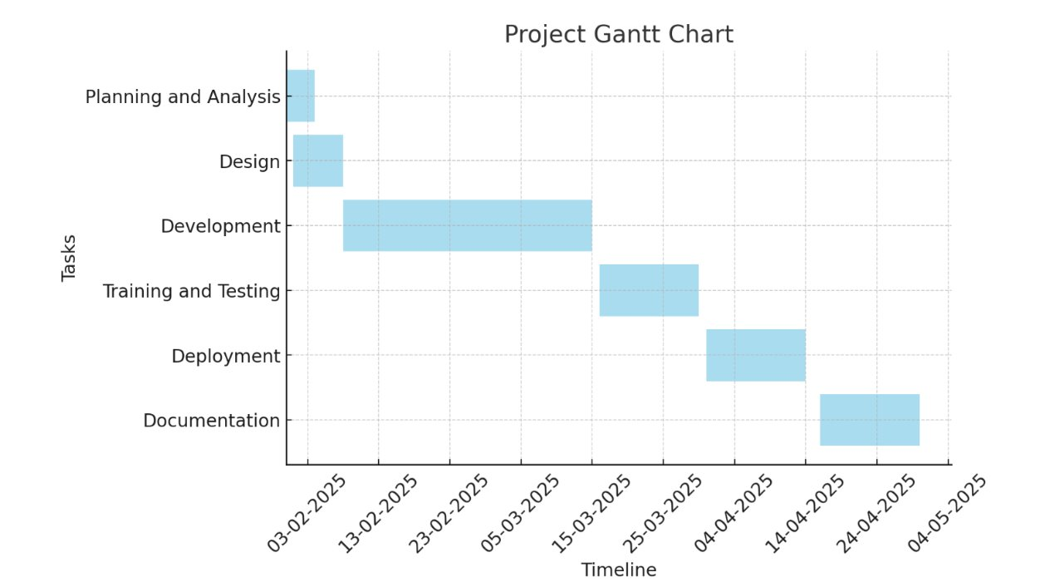
Timeline of Project

Slide 11
Expected Outcomes
Automated Legal Document Generation – Reduction in manual effort through AI-driven contract and agreement drafting.
Enhanced Accuracy & Compliance – Improved legal document quality with AI-powered clause analysis and risk detection.
Time & Cost Efficiency – Faster legal documentation processes, reducing turnaround time and operational costs.
Improved Accessibility & Understanding – Simplified legal language and AI-generated summaries for better comprehension.
Secure & Efficient Document Management – Encrypted storage, role-based access, and seamless integration with legal databases.

Slide 12
Conclusion
The AI-Powered Legal Documentation Assistant automates the drafting, review, and compliance verification of legal documents using advanced Artificial Intelligence (AI) and Natural Language Processing (NLP) techniques. This reduces the dependency on manual work and speeds up the document creation process.
The platform provides an intelligent search and risk assessment feature, enabling users to quickly retrieve relevant legal documents, contract clauses, and case laws. Additionally, AI-powered risk detection highlights potential legal pitfalls, missing clauses, or inconsistencies.
Secure document management is ensured through encryption and role-based access control, protecting sensitive legal information from unauthorized access and cyber threats. The system maintains compliance with industry security standards for data protection.
Overall, the AI-powered solution improves efficiency by streamlining legal documentation processes, making them faster, more reliable, and cost-effective. It empowers legal professionals to focus on critical decision-making rather than spending excessive time on repetitive tasks.

Slide 13
Github Link
https://github.com/Sirihg-12/AI-Powered-Legal-Documentation-Assistant

Slide 14
References
Imogen, P. V., Sreenidhi, J., & Nivedha, V. (2024). AI-Powered Legal Documentation Assistant. Journal of Artificial Intelligence and Capsule Networks, 6(2), 210-226. This paper discusses the development of an AI-powered tool designed to assist in legal documentation, focusing on areas like copyright, trademark, and banking.
Johnson, D., & Lee, R. (2020). An Approach to Get Legal Assistance Using Artificial Intelligence. 2020 8th International Conference on Reliability, Infocom Technologies and Optimization (Trends and Future Directions) (ICRITO), 1185-1190. This study proposes a Virtual Legal Assistant (VLA) comprising four components that enable legal experts to consult on legal situations interactively through an AI-based virtual assistant. The approach aims to address the backlog of cases in Indian courts by providing accessible legal assistance, especially in rural areas.
Patel, A., & Gupta, S. (2024). LEGALSEVA - AI-Powered Legal Documentation Assistant. International Research Journal of Modernization in Engineering Technology and Science, 6(3), 215-221. This project presents LEGALSEVA, an AI-powered platform designed to enhance the accessibility and clarity of legal processes. By leveraging advanced technologies and focusing on user-centered design, the platform aims to transform legal documentation, making it more efficient and user-friendly.
Wang, L., Chen, Y., & Zhang, T. (2023). Design and Implementation of a Chatbot for Automated Legal Assistance. Journal of Emerging Technologies and Innovative Research, 11(4), 45-52. This paper details the creation of a chatbot utilizing Natural Language Processing (NLP) and Machine Learning algorithms to provide automated legal assistance. The chatbot is designed to offer conversational support for legal research, aiming to improve accessibility and efficiency in obtaining legal information.
5. Brown, M., & Taylor, J. (2024). AI & ML Based Legal Assistant. International Research Journal of Engineering and Technology, 9(12), 102-108. This research explores the integration of Artificial Intelligence (AI) and Machine Learning (ML) in legal tasks, focusing on automating courtroom operations.

Slide 15
References
Kumar, S., & Singh, R. (2024). SIMPLILEGAL: An AI-Powered Legal Document Assistant. International Journal of Engineering Innovations and Management Strategies, 1(8), 55-63. SIMPLILEGAL is an AI-driven platform aimed at simplifying the drafting and analysis of legal documents. The system focuses on enhancing efficiency and accuracy in legal documentation, providing users with tools to navigate complex legal requirements effectively.
Davis, K., Patel, S., & Nguyen, L. (2024). Chatlaw: A Multi-Agent Collaborative Legal Assistant with Knowledge Graph Enhanced Mixture-of-Experts Large Language Model. Artificial Intelligence for Legal Assistance Workshop. This study introduces Chatlaw, a collaborative legal assistant that employs a Mixture-of-Experts model enhanced with knowledge graphs. The system aims to reduce AI hallucinations and improve the reliability of legal assistance provided by AI models.
Hernandez, A., & Zhao, Q. (2024). AI-Powered Legal Documentation Assistant. International Journal of Engineering Innovations and Management Strategies, 1(8), 64-72. This paper discusses an AI-powered solution for legal document management, focusing on streamlining the drafting and analysis processes. The system aims to enhance efficiency and accuracy in legal documentation, addressing potential integration challenges with existing systems.
Miller, J., & Wong, E. (2024). Enhancing Legal Document Management Efficiency: An AI-Powered Solution. International Journal of Engineering Innovations and Management Strategies, 1(8), 73-81. This research explores the application of AI in legal document management, aiming to improve efficiency and accuracy. The study also addresses potential data privacy concerns associated with implementing AI-driven solutions in legal contexts.
Nakamoto, S., Patel, R., & Gupta, A. (2020). Artificial Intelligence as Legal Research Assistant. SSRN Electronic Journal. This paper examines the role of AI in legal research, focusing on text retrieval and semantic segmentation techniques. The study highlights how AI can make legal information more accessible, while also considering the computational resources required for such implementations.

Slide 16
Thank You

